Slide 1
THE BEVERLY HEIGHTS COMMUNITY LEAGUE PROUDLY PRESENTS
The 53rd Annual
Variety Show

Slide 2
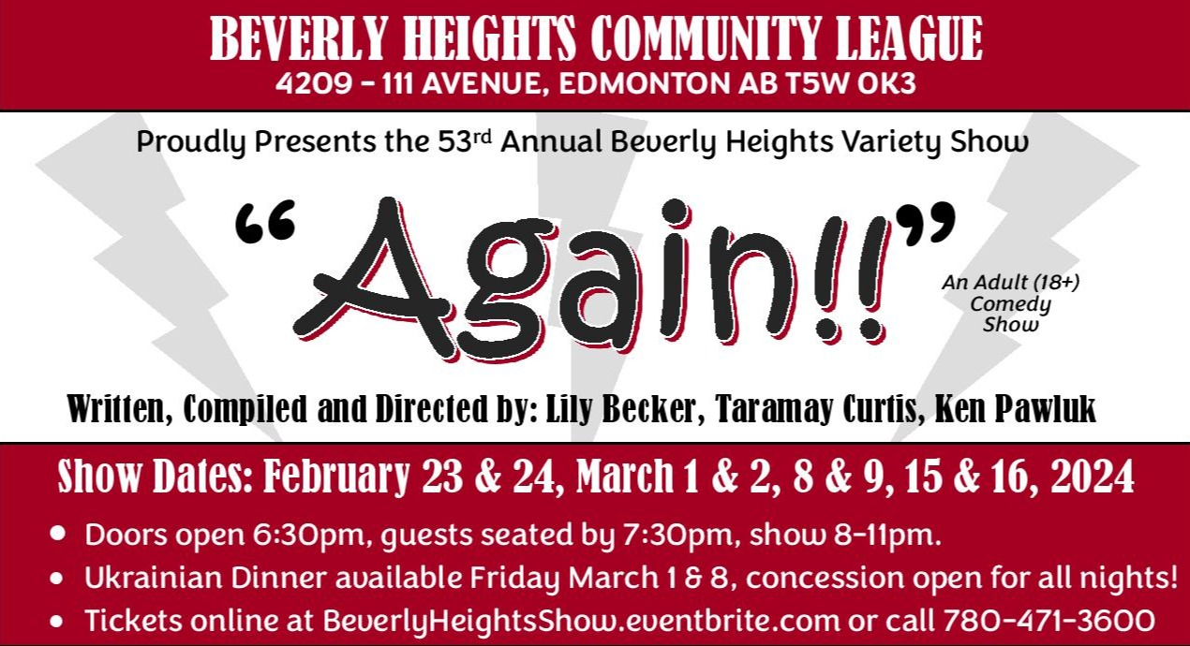

Slide 3
Written, compiled & Directed by
Lily Becker

Slide 4
After a successful 20 years Lily decided to take a break from the Beverly Heights Variety Show. She didn't realize until later what a mistake she made...
10 years later they found her feral behind the hall and invited her back.
Lily is back to be part of the laughs, music, community and hopefully full of pierogies!

Slide 5
Written, compiled & Directed by
Taramay Curtis

Slide 6
“29 years ago I showed up at the hall. They fed me, I stayed. In those 29 years, I sat in a box as part of the band. I then got my paws extra dirty with writing and directing and scratched out 5 shows. If the feline is mutual, I'm gonna stick around a bit longer!” Taramay Curtis

Slide 7
Written, compiled & Directed by
Ken Pawluk

Slide 8
Ken joined the Beverly Heights Variety Show in 1977 and started performing at the age of 13 in the Peter & Gabe Road Shows. This show is Ken’s 12th as Co-Writer/ Director! Ken was in the very first Castledowns VS and performed in the very last Wellington VS, as well as 4 years in the Klowchuk Days VS.

Slide 9
FEATURING the ALL-STAR CAST: (in alphabetical order)

Slide 10
“Miss Laura”
Miss Laura started her BHVS career in 2007!
Her background in the art of Burlesque has fanned her natural talents for making people smile and laugh.
Miss Laura loves being a grandmother to her two wonderful grandsons.

Slide 11
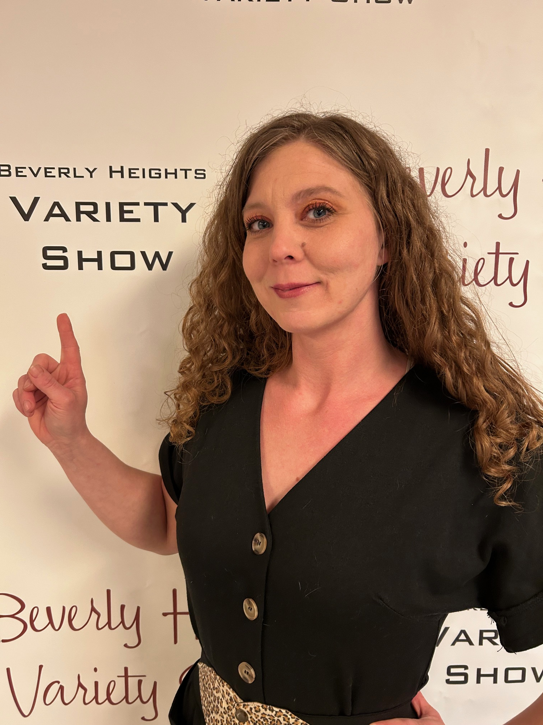
Fae-Lynn Bochanesky
Fae-Lynn joins us for her first BHVS show and is already planning to come back next year – so much fun!
Fae-Lynn is a dedicated Domestic Engineer and has lived in the Beverly area 6 years and doesn’t plan on leaving!

Slide 12
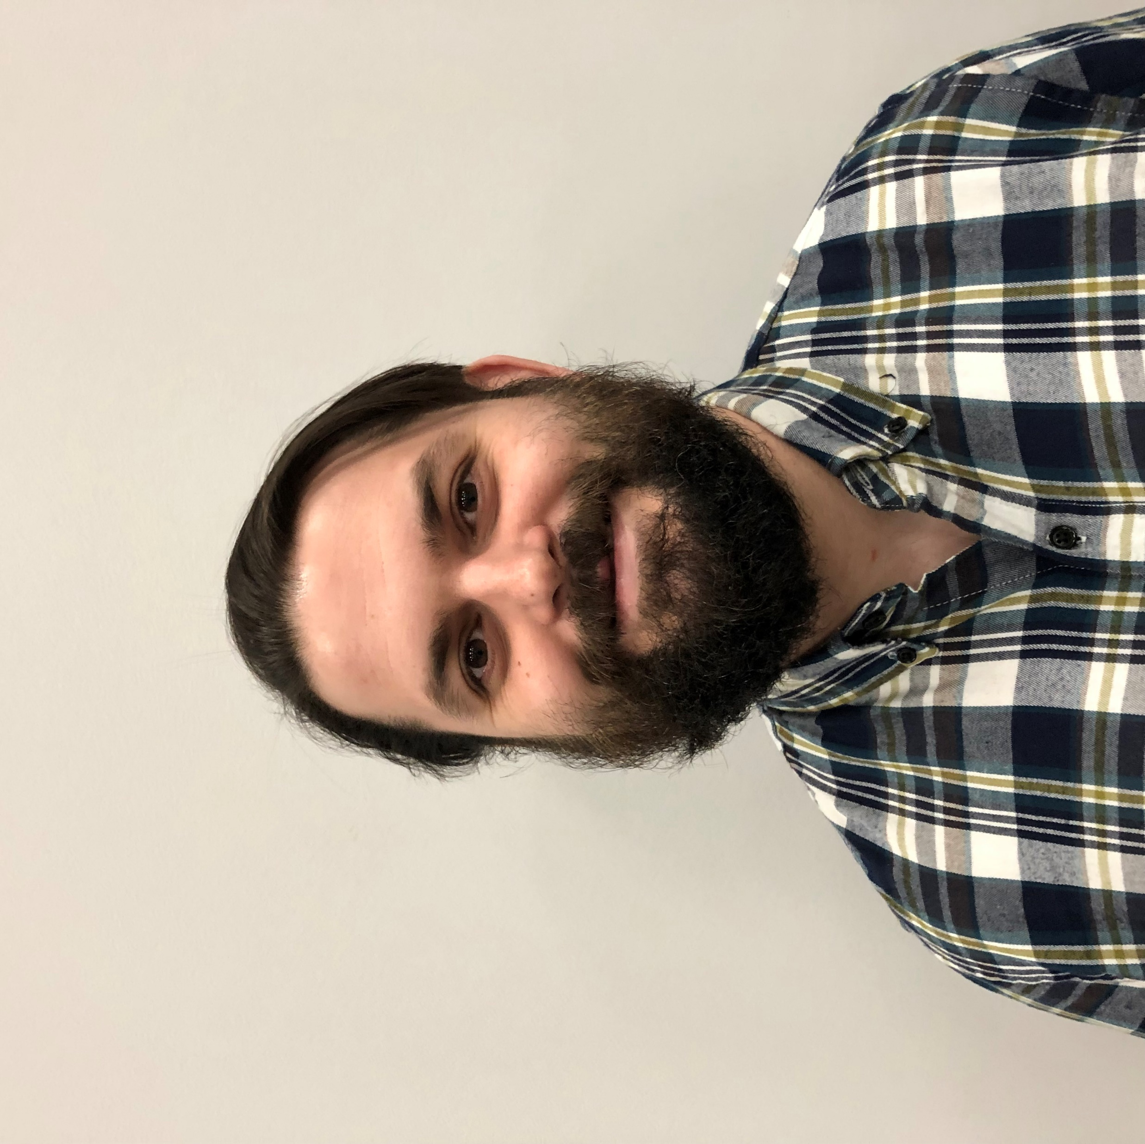
Tristan Dee
Tristan is performing in his second BHVS show!
Tristan has written FOUR shows, and performed in TWELVE shows, with the Castledowns Variety Show!

Slide 13
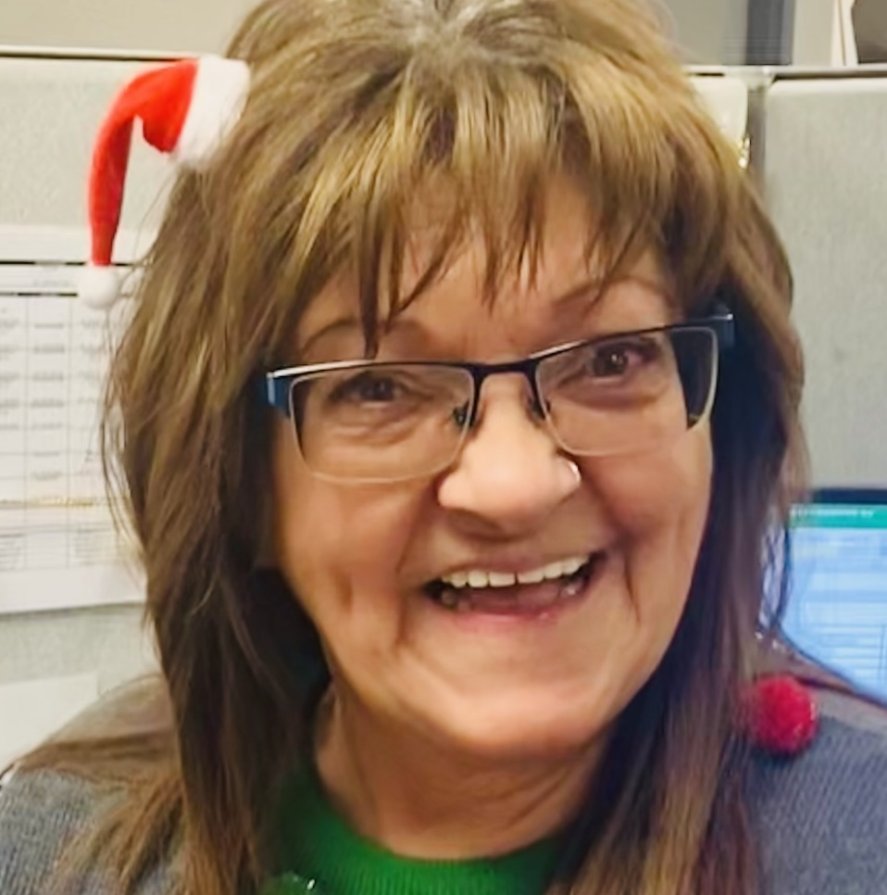
Cheryl “Dowhan”
Cheryl has been in the BHVS cast since 1992!
Before joining the cast, Cheryl started serving drinks to BHVS patrons in 1987.
She loves having fun and making people laugh, that is why she is back again!

Slide 14
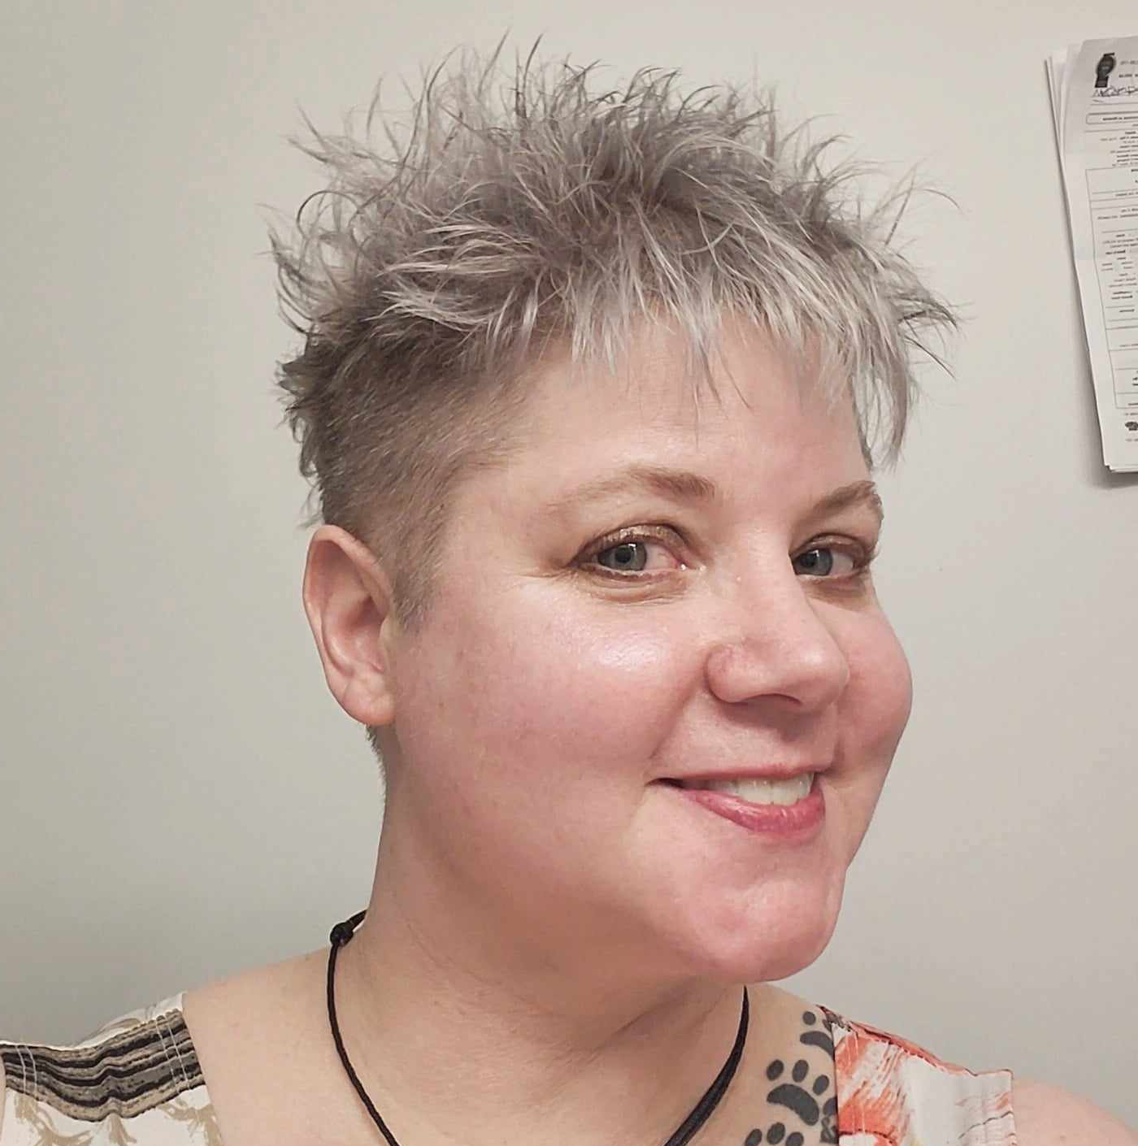
Corrie Gardner
Corrie is excited to be performing in her first BHVS show and is already looking forward to coming back again next year!
Corrie also debuted in the 2023 Castledowns Variety Show – she has had two “first times” in the last year!

Slide 15
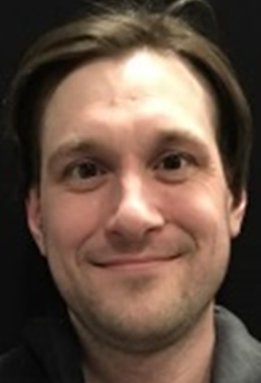
Simon Gushulak
Simon has tried out almost every BHVS volunteer role – spotlight, backstage mic guy, performing in the band, in the cast, and even co-wrote/directed a show!
Simon is a puppeteer for Duffy’s Puppets, is a singer/songwriter and plays in the band “Mandaku”.

Slide 16
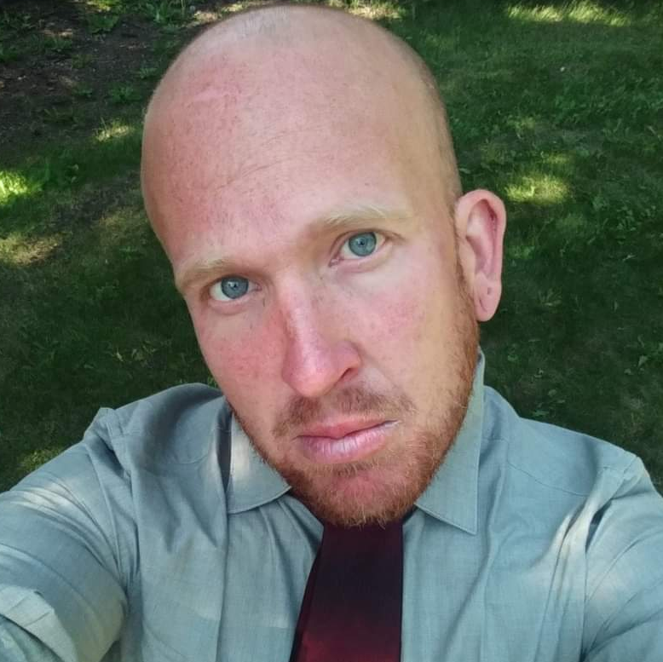
Chris Hill
Chris last performed in the 2020 BHVS show and is back for another season!
“Through life itself, monsters and angels are made. Through it all, true humans are created. Learn everyday!”

Slide 17
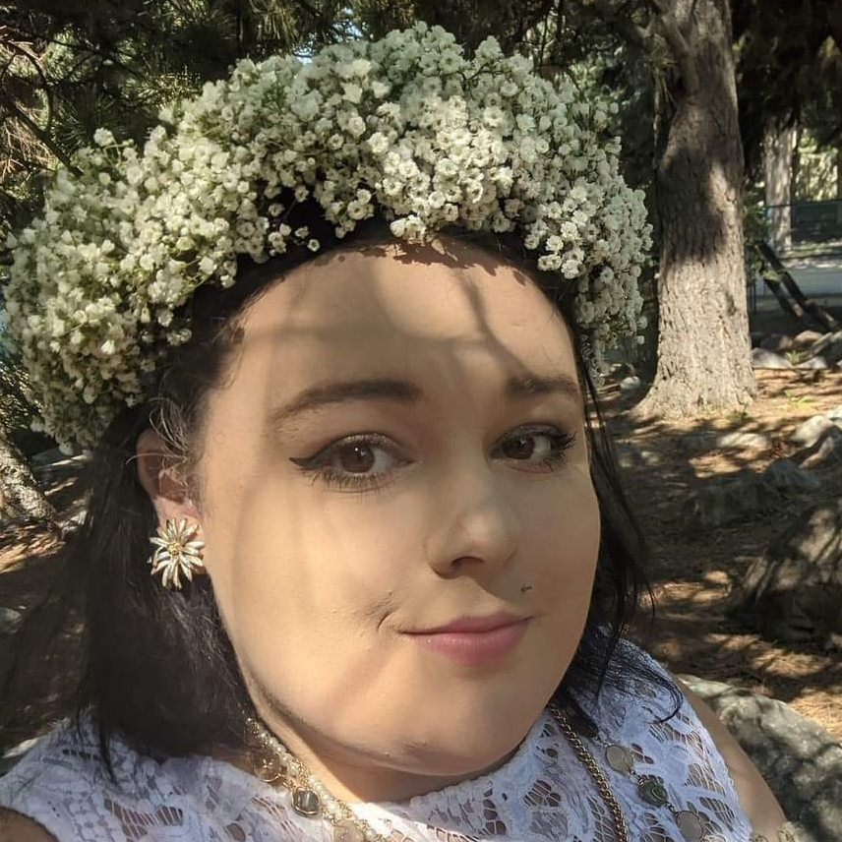
Quinn Hill
Quinn last performed in the 2020 BHVS show and is back for another season!
Hobbies include singing, acting, painting, drawing and dancing, and she participated in the Nancy Applebee Theatre Theatrical Competition in 2016!
“Blessed is the nightbird that sings for joy and not to be heard” – as much as I love singing it’s hard for me to be noticed but I do it because I love it!

Slide 18
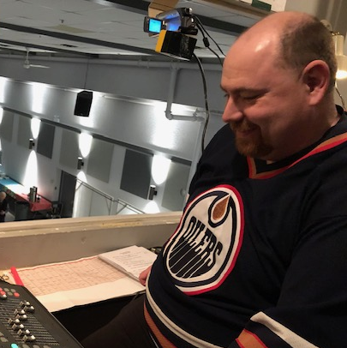
Dave Kendrick
Dave is performing in his first BHVS show after being a sound/lights volunteer since 2019!
Dave acted in plays in high school and followed that up with radio broadcasting school.
Dave is a dad to two fur babies ☺

Slide 19
Kathrine Morissette
Kathrine has been performing in the BHVS show since 2018.
“I’ve been in the Beverly Show for the past 6 years and it has been a blast, this, however, will be my last! Thanks for helping me break out of my shower singing shell.”

Slide 20
Angela Murdoch
Angela is performing in her first BHVS show!
In the past she tried out for Canadian Idol, and a few karaoke competitions. This is her first time stepping on stage trying her hand at comedy and acting.
“My friends like to call me fun and outgoing. This "ENERGIZER BUNNY" likes to always keep the dance party going. Oh – and I am a groupie of a certain member of the band.”

Slide 21
Eldon Niederhaus
Eldon is celebrating performing in his 29th BHVS season! He’s still having fun and looking forward to next year.
FIREBALL FRIDAYS – Cheers to you!

Slide 22
Tara “MoHo” Peterson
Tara joined the BHVS cast in 1999 and this is her 25th year performing! Wow!
Tara has a “great zest” for life and shows that in everything she does with her family and friends; whether it’s travelling, camping, or watching the Oilers games!
The only thing that slows her down are SPIDERS!

Slide 23
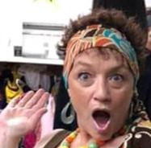
Teena Pich Lantz
Teena is performing in her 4th BHVS show!
Teena also performs with the Castledowns Variety Show.
“DON’T CALL ME CRAZY, I prefer the term mentally hilarious!”

Slide 24
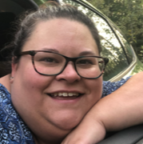
Natasha Pursky-Swityk
Natasha joins the BHVS cast for her first show! We are thrilled to welcome her to the stage.
“I am shy at the beginning, but once I’m comfortable I will be really funny!”

Slide 25
Wayne Quackenbush
Wayne is back for his 5th BHVS season!
Wayne is an amateur artist and would rather be painting or acting than working.
“Doing volunteer community works is better than jail time...”

Slide 26
Danielle “Dani” Smith
Dani is back for her 6th season with the BHVS!
Dani was in a semi-professional theatre group travelling around Alberta.
In her spare time, Danielle works on creative projects – sculpting, painting, drawing, and more!

Slide 27
Kathy “Kat” Stark
This is Kathy’s third BHVS show!
She had so much fun learning choreography, studying lines, and getting different costumes together that she was counting down the days to come back!
Kathy loves animals, camping, and spending time with her family.

Slide 28
Justin Webber
Justin is back on stage for his 6th BHVS season!
Like several other cast members, Justin started off by volunteering behind the scenes.
Justin loves animals, and if the opportunity arises would like to be a TV star.

Slide 29
Alyssa “Bee” Zaminer
Alyssa is joining the BHVS cast for the first time!
If she looks familiar it’s probably because she signed you up for your Costco membership.
“I wonder if chicken wings think about me too? Hi Mom!!”

Slide 30
Introducing the incredibly talented Variety Show Band!

Slide 31
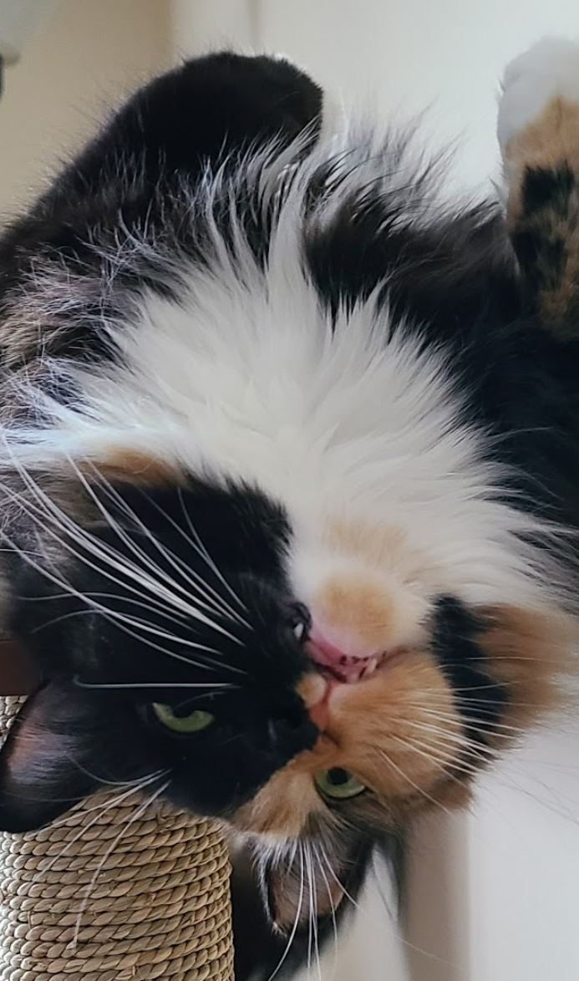
Taramay Curtis Keyboards, Vocals
Her cat just can't wrap her head around the fact that Taramay has been doing this show going on 29 years!!
In addition to writing and directing several shows, she is “taking up space” in the bandstand (where she keeps busy checking out the snacks you bring!!)

Slide 32
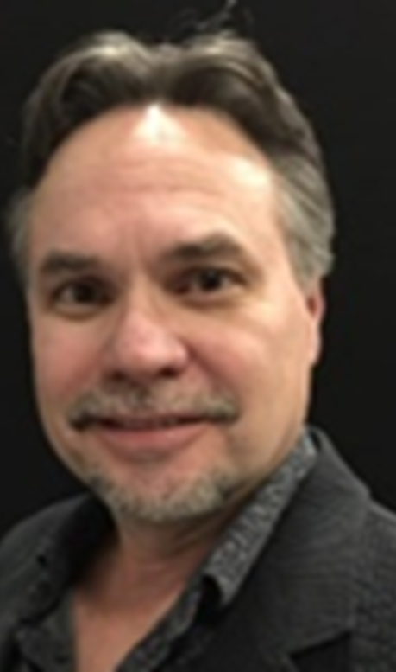
Will Moellering Bass, Vocals
Will is proud to be part of the Beverly Heights Variety Show since the late 70’s when the show would go on the road and perform in small towns (of course he was underage at the time)!
Will grew up in Beverly and has written/directed several shows over the years.

Slide 33
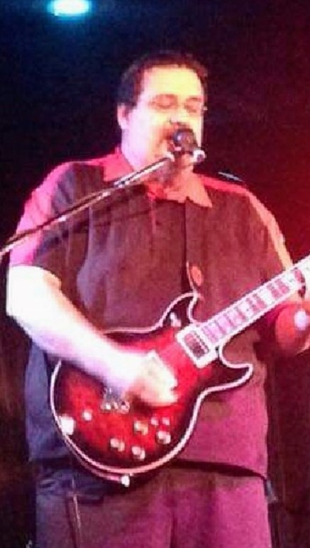
Marcel Murdoch Guitar, Vocals
Marcel is back for his second season with the Beverly Heights Variety Show!
Check out his YouTube channel “Murdoch Guitar – YouTube” – he will blow you away!

Slide 34
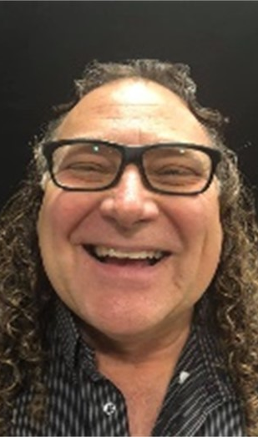
Ken Pawluk Drums
Ken is very proud and honoured to be a part of the BHVS show, and/or playing drums in the Variety Show Band, for an incredible 43 years.

Slide 35
And now… a word from our sponsor!

Slide 36
PLEASE CHECK YOUR COAT!
Our volunteers will be serving patrons and walking between the narrow rows between the seats.
Coats on the back of your seat ARE A TRIPPING HAZARD!
For the safety of our volunteers, PLEASE CHECK YOUR COAT!
The coat check is FREE and you can retrieve and recheck your coat at any time.

Slide 37
And now… a word from our sponsor!

Slide 38
HOUSE RULES…
No smoking in the hall. Designated smoking area is outside the main doors!
No liquor outside our main doors.

Slide 39
HOUSE RULES…
All beverages must be purchased on site.
Raise your hand for a drink during the performance.

Slide 40
HOUSE RULES…
Please turn cell phones to silent or turn them off!
Washrooms are located in the lobby.

Slide 41
And now… a word from our sponsor!

Slide 42
Just in case…. better safe than sorry!
Check for your nearest emergency exit – two exits on the east side of the main hall, or exit through the lobby and out the main door.
Emergency fire pull stations are located near the exits.
Emergency evacuation routes and procedures are posted just inside the hall near the lobby doors (and the fire extinguisher) and near the main entrance in the lobby.

Slide 43
Please keep table talk to a minimum, and laughter to a maximum! Enjoy the show!

Slide 44
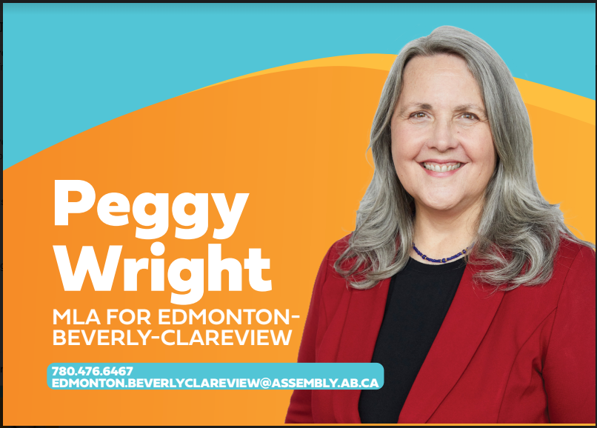
And now… a word from our sponsor!

Slide 45
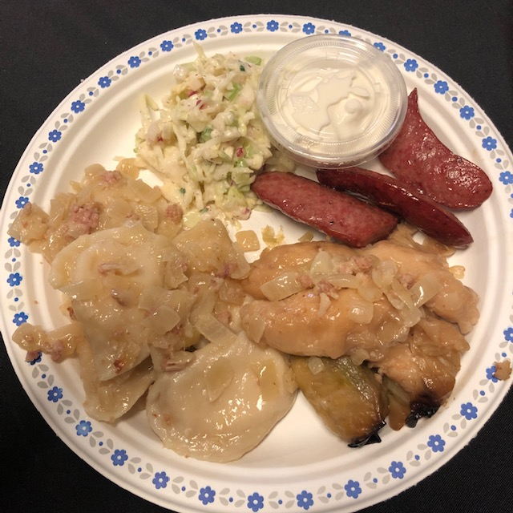
Paulina’s Catering 2 Friday Nights only: March 1 or March 8
Ukrainian Dinner Plate $21
Potato cheddar perogies, cabbage rolls, roasted garlic sausage, creamy coleslaw and sour cream.
Served only until 8pm, tickets in the lobby (limited quantities!)

Slide 46
And now… a word from our sponsor!

Slide 47
BHVS CONCESSION
Wings (S&P, Teriyaki or Honey Garlic)
Hamburger
Nachos & Cheese
Caesar Salad
Popcorn
Chips
Sweet treats
Coffee (add a shot of Baileys from the bar!)
Full menu with descriptions & prices on the display near the kitchen or on the tables!

Slide 48
And now… a word from our sponsor!

Slide 49
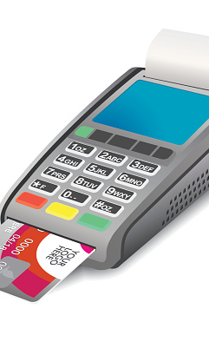
FORGOT CASH?
Debit accepted at the token booth for concession or token purchases
(no cash back, cannot be used for raffles)

Slide 50
FROM THE BAR
RED DRINK TOKEN: $5 each
-Highballs -Cocktails
-Liqueurs -Shots
-Beer -Coolers
-Wine
(4 red tokens for bottle of wine)
$5
Sorry – no refunds on token purchases

Slide 51
And now… a word from our sponsor!

Slide 52
FROM THE BAR
BLUE DRINK TOKEN: $1 each
-Water -Iced Tea
-Diet Coke -Cranberry
-Coke -Clamato
-Sprite -Soda Water
-Ginger Ale -Tonic Water
$1
Sorry – no refunds on token purchases

Slide 53
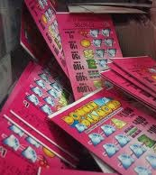
GET LUCKY TONIGHT!
Get your 50/50
and Nevada Pull
tickets in the lobby!
-Instant win Nevada prizes
-50/50 draw nightly!

Slide 54
And now… a word from our sponsor!

Slide 55
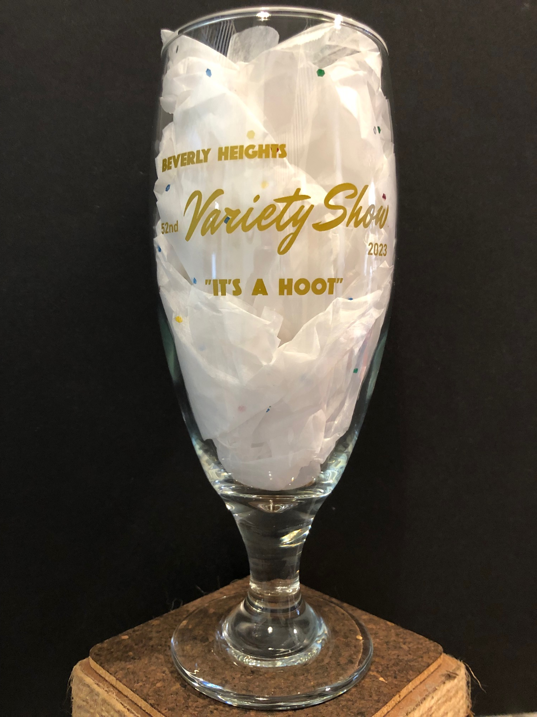
Get your bhvs Merch! Take home a piece of Variety Show History
16 oz/473 ml
Pilsner Glass
(While quantities last,
from 2023 show)
Includes FREE non-alcoholic beverage refills all night!
Just $5 each
At the Token Booth

Slide 56
WE VALUE YOUR FEEDBACK! FILL IN THE COMMENT CARD ON THE TABLE OR IN THE LOBBY!

Slide 57
And now… a word from our sponsor!

Slide 58
Did you know that the cast, crew, bartenders, floor staff, ticket and token sellers, set-up/clean-up crew and planning committee are all volunteers? So many hours have gone into bringing this fundraiser to life over the past 53 years! Thank you to past volunteers, and those working tonight.
Thank you, Volunteers!
Without you the show would not go on!

Slide 59
Volunteer team leaders volunteer, but they also plan the shifts, recruit, schedule, train and supervise volunteers plus are responsible for setting up, getting supplies, and managing their area.
A HUGE THANK YOU to this year’s team leaders!

Slide 60
Volunteer Team Leaders
Admission | Tracey Hirtle
Bar | Todd Mishio
Coat Check | Bev Trudel
Costumes | Val Antoski
Financial Control | Jim Trudel
Floor Staff | Joyce Kutnikoff
Kitchen & Concession | Silvia Lutic & Theresa Winnichuk
Lighting & Sound | Aaron Weicker
Nevada & 50/50 Tickets | Darlene Mosiuk

Slide 61
Volunteer Team Leaders
Prop Prep & Painting | Carol Smith, Dana Peterson, Dani Smith, Cindy Webber
Set-up/Clean Up | Alvin & Jackie Ewanchuk
Stage Manager/Props | Ken Boyde
Sponsors & PowerPoint | Sara Zurbrigg, Tracey Hirtle
Technical Consultant | Jason Grilo
Ticket Sales | Sally Waselenchuk, Sara Zurbrigg
Token Sales | Edie Boonstra
Volunteer Wind Up | Joyce Kutnikoff

Slide 62
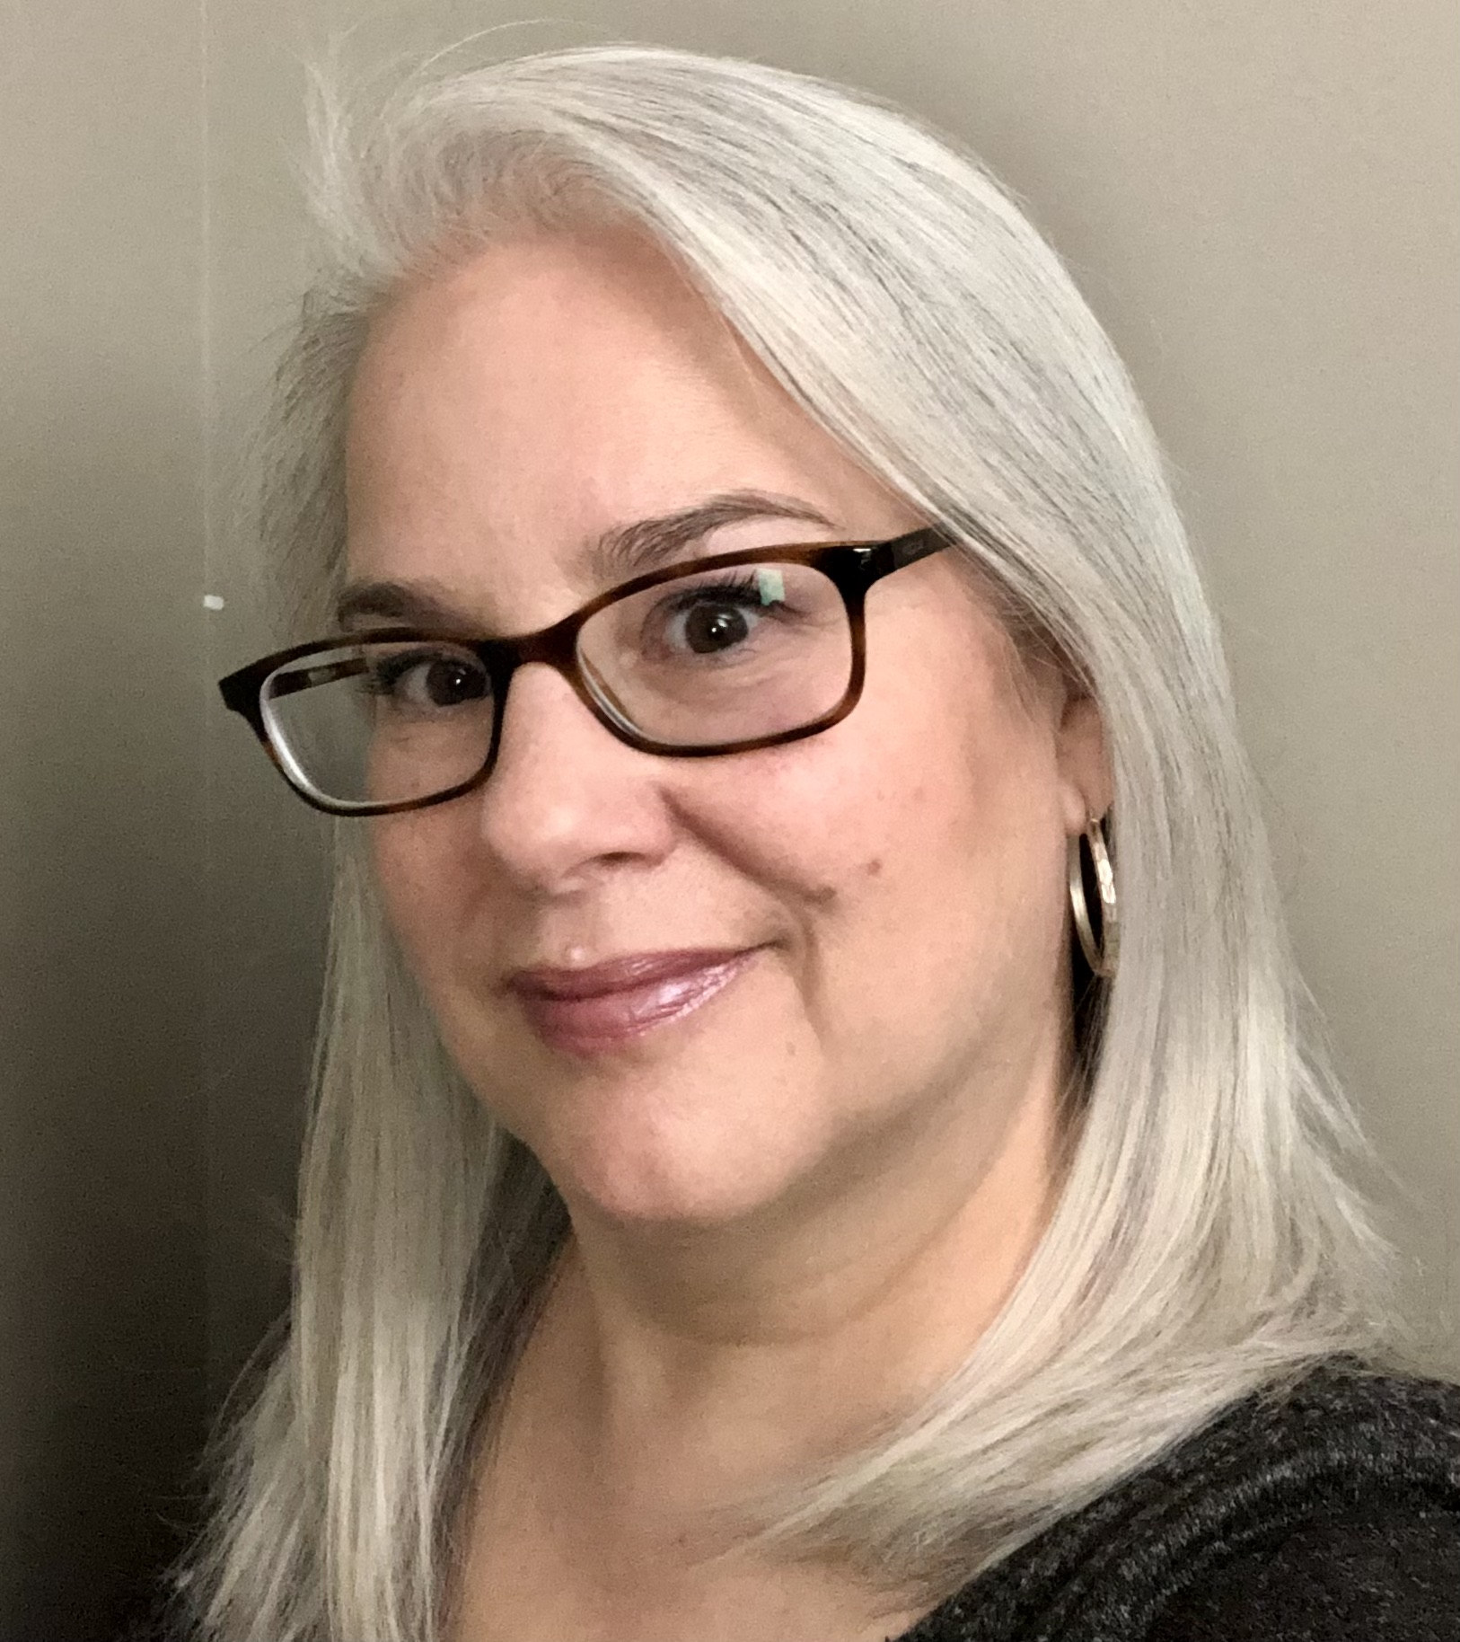
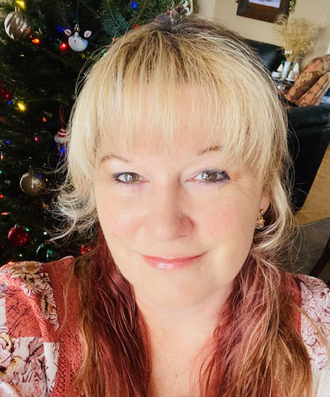
2024 Variety Show Committee
The Variety Show committee plans the show dates, reviews the show writer applications, and do all the odd jobs needed to make the show a blockbuster!
After the shows are done, we host a fun Volunteer Wind Up to celebrate the show and the contribution of the wonderful volunteers.
Sara Zurbrigg – Chair
Joyce Kutnikoff – Co-Chair
Ken Boyde
Tracey Hirtle
Join the 2025 Variety Show Committee! New members always welcome.

Slide 63
And now… a word from our sponsor!

Slide 64
And now… a word from our sponsor!

Slide 65
And now… a word from our sponsor!

Slide 66
And now… a word from our sponsor!

Slide 67
And now… a word from our sponsor!
mcmunninspections.info

Slide 68
And now… a word from our sponsor!

Slide 69
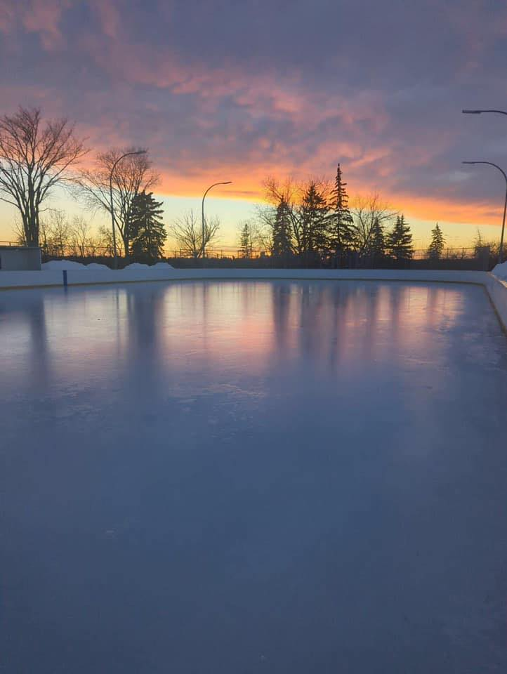
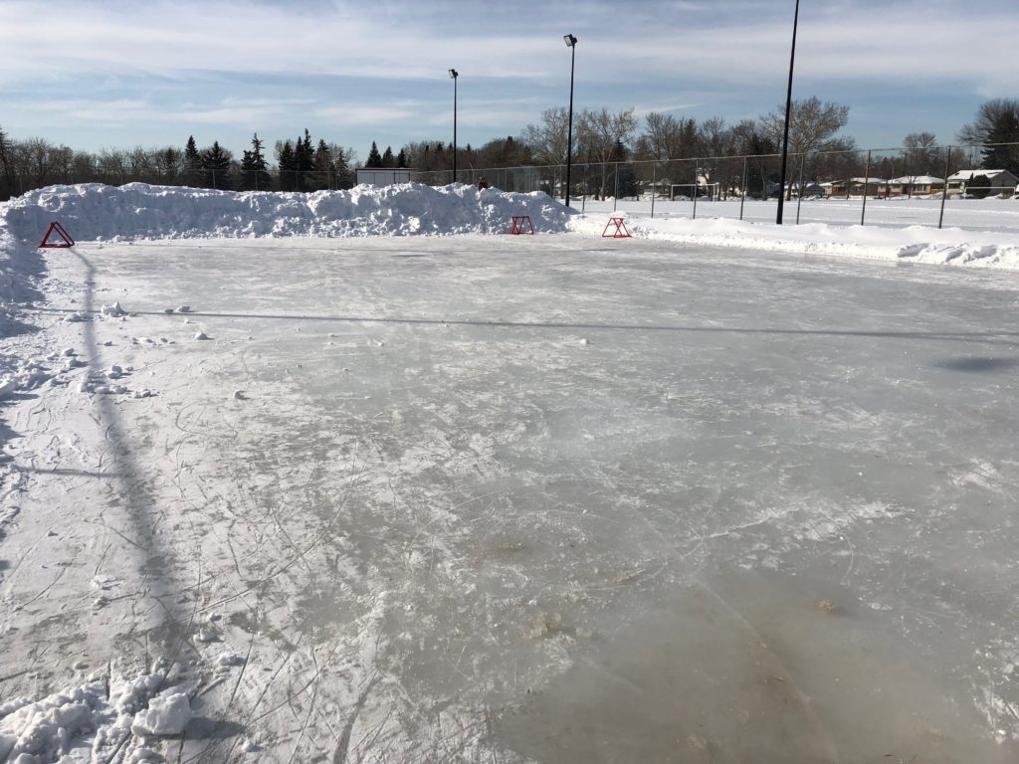
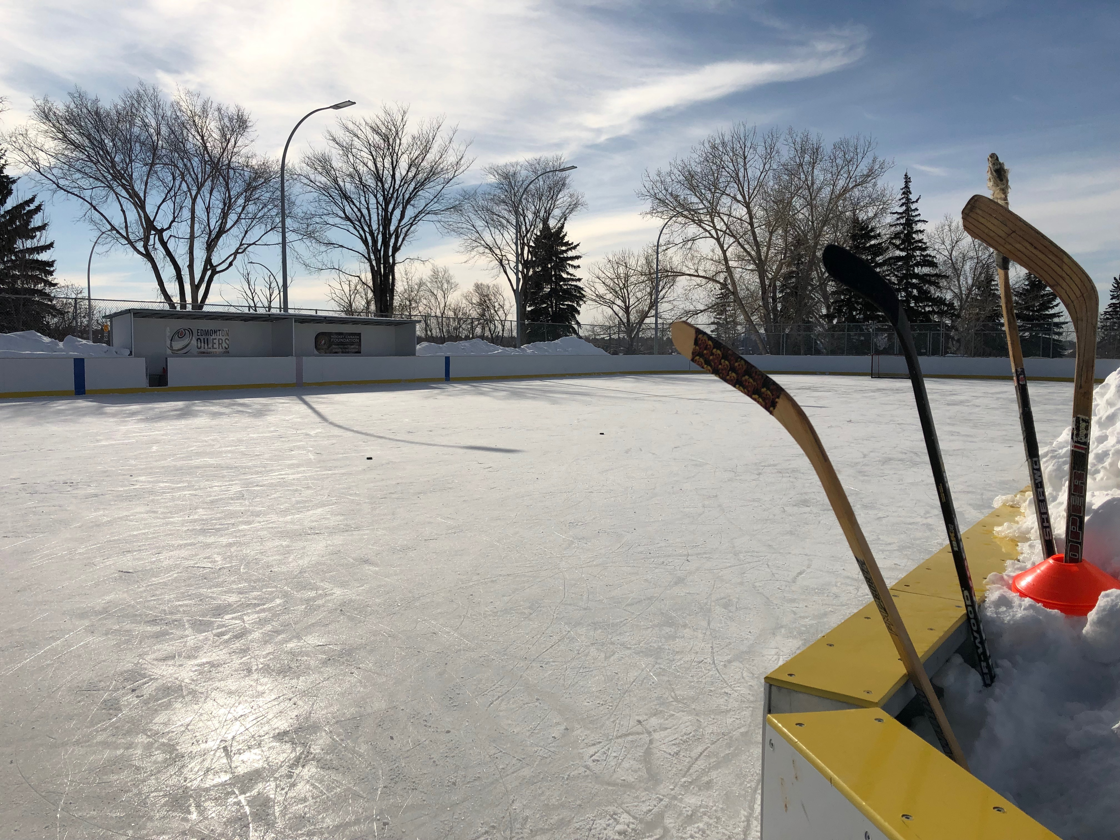
By supporting the Variety Show you are supporting… …the Beverly Heights Community League programming for youth, adults and seniors.
Beverly Boarded & Snowbank Rinks
open November/December to February

Slide 70
By supporting the Variety Show you are supporting… …murals in the community

Slide 71
By supporting the Variety Show you are supporting… …maintaining this hall and the family centre for events, community gatherings, activities, and rentals.

Slide 72
By supporting the Variety Show you are supporting… …activities and programs for community members like Yoga, Hip Hop, Coffee Drop In, Safety Forums, and Community League Day.

Slide 73
YOU ARE VERY APPRECIATED! Thank you for supporting the Beverly Heights Variety Show!

Slide 74
Please support the incredible local businesses advertised here tonight
Check them out!
They are awesome!!

